Slide 1
Session 14
IOStreams

Slide 2
Session Objectives
Discuss IOStreams
Work with File IOStreams
Format Output stream
Create Manipulators

Slide 3
Streams
Can be viewed as a common logical interface to the
devices of a computer.
Links the physical I / O devices with the C++ I / O
system.
The stream used to input data to a program is known as
input stream.
The stream used to output data is known as the output
stream.

Slide 4
Types of Streams
There are two types of streams -
Text -
A text stream is linked with ASCII characters.
Binary -
In binary stream there is no character
translation as in the text stream.

Slide 5
Predefined Streams
Whenever a C++ program is executed, there are some
predefined streams, which are automatically opened -
cin
Associated with Standard Input
cout
}
cerr
Associated with Standard Output
clog

Slide 6
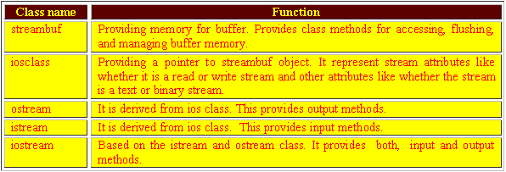
Managing Streams
Given below is a list of some classes and the
functionality associated with them -

Slide 7
Insertion Operator <<
Output on the standard stream is done using the cout
object of the ostream class
This class overloads the bitwise left-shift operator.
Overloaded for performing output.
cout << variable ;

Slide 8
The ostream class (1)
The operator function ‘<<‘ is overloaded and it returns a
reference to the class ostream
ostream &operator << (int n) ;

Slide 9
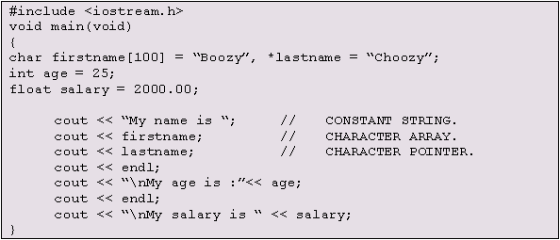

The ostream class (2)
Output -

Slide 10
Other ostream functions (1)
Apart from the overloaded operator <<, the ostream
class provides some other functions for output.
ostream &put (char) ;
Only prints characters.
cout put ('v');
.
This function also returns a reference to the cout object.

Slide 11
Other ostream functions (2)
There is another function write() in this class.
ostream &write (char *, int);
This function prints an entire string.

Slide 12
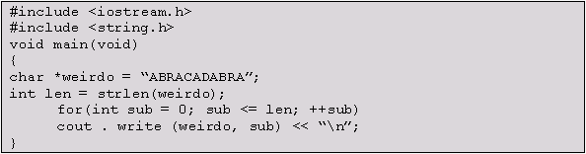
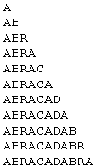
Other ostream functions (3)
Output -

Slide 13

Other ostream functions (4)
The function flush() can be used to flush the output buffer.
The function endl() prints a new line character.
or

Slide 14
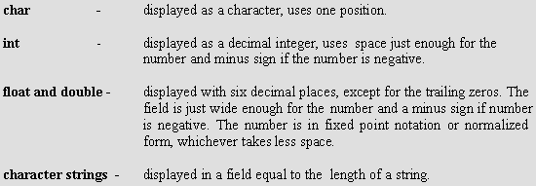
Formatting output with cout (1)
The overloaded functions for the insertion operator << of
the ostream class formats the variables before displaying.
Default format -

Slide 15
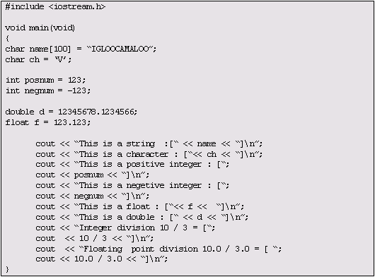
Formatting output with cout (2)

Slide 16
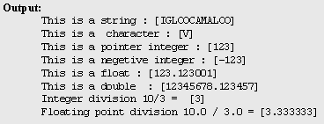
Formatting output with cout (3)
Output

Slide 17
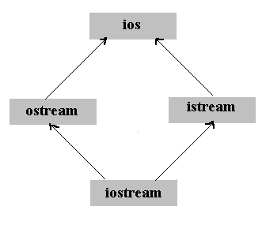
Manipulators (1)
There are several classes in the iostream.h header file.

Slide 18
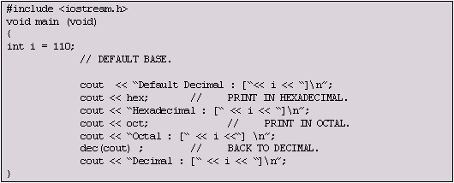

Manipulators (2)
Output -

Slide 19
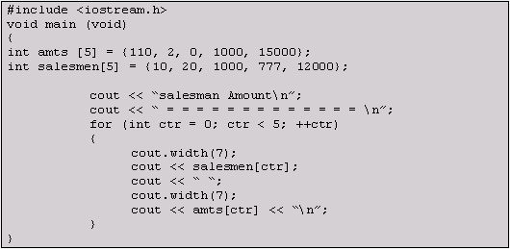
Changing Field Width (1)

Slide 20
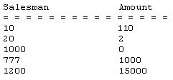
Changing Field Width (2)
Output -

Slide 21
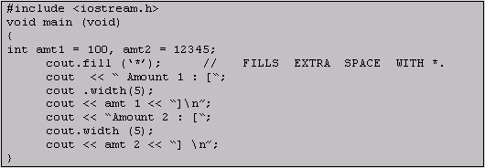

Padding the extra places
Output -

Slide 22
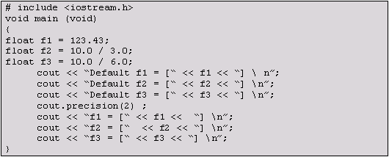

Setting The precision
Output -

Slide 23

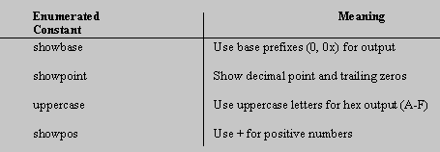
The setf() function (1)
The function only has the following prototypes -
Can have any one of the following arguments -

Slide 24
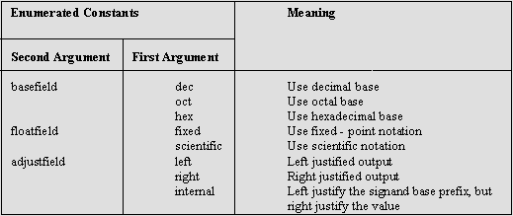
The setf() function (2)
The second prototype can have any of the following
arguments -

Slide 25
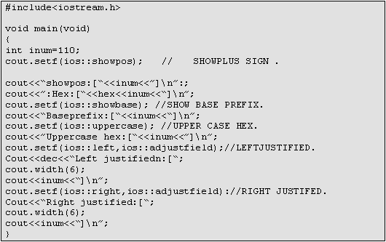
The setf() function (3)

Slide 26

The setf() function (4)
Output -

Slide 27
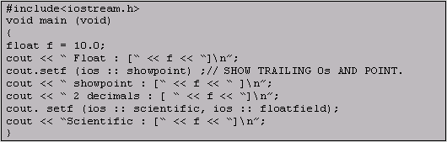

The setf() function (5)
Output -

Slide 28
The Overloaded Extraction Operator (1)
Syntax -
cin >> variablename

Slide 29
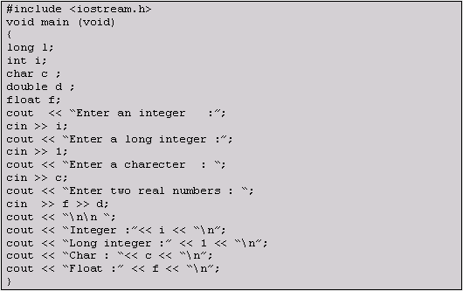
The Overloaded Extraction Operator (2)

Slide 30
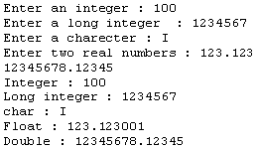
The Overloaded Extraction Operator (3)
Output -

Slide 31
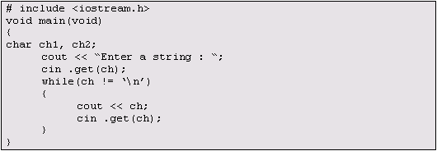
Other istream functions
Apart from the overloaded functions for the extraction
operator, the istream class also has some other functions
for input; one of them is the get().

Slide 32
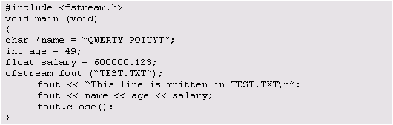
File Input / Output (1)
Creating a file for output -
Output -

Slide 33
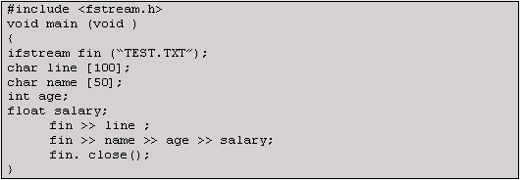
File Input / Output (2)
Creating a file for Input -

Slide 34
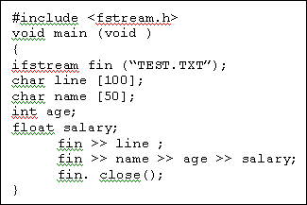

Other I / O functions (1)
The get() and the getline() functions are also used on a
large scale for file input and output.
Output -

Slide 35
Other I / O functions (2)
int eof(void)
int fail(void)
void clear(int newvalue=0)

Slide 36
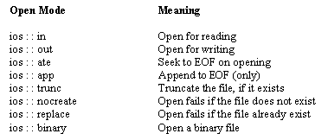
Other I / O functions (3)
void open(char filename int openmode)

Slide 37

Other I / O functions (4)

